Slide 1
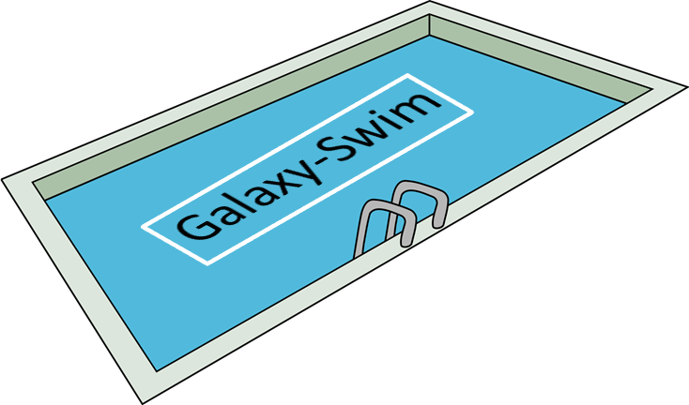
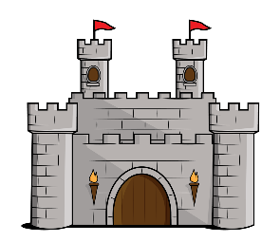
Worldwide Medieval Magic Deck Preview+ Valentine’s Day Deck Preview
Magician
Trading Cards
Magician
Trading Cards
Magician
Trading Cards
Magician
Trading Cards
571
571
571
571
Notes:
King Arthur had a royal magician? Medieval Magic Deck introduces harvest stalks, stalks which you get more of each turn. *note: this deck comes with an extension, The Harveston Galaxy COMING SOON!

Slide 2
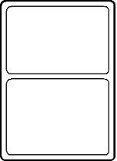
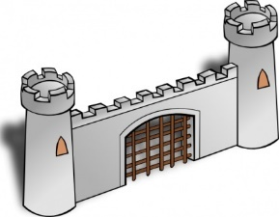
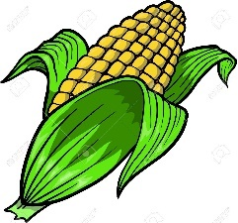
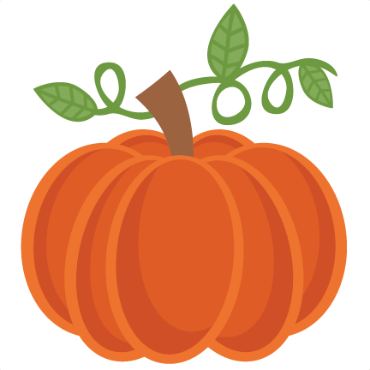
Wall
May be used once by a player. Wall protects any one stalk from being taken.
Wall
May be used once by a player. Wall protects any one stalk from being taken.
Wall
May be used once by a player. Wall protects any one stalk from being taken.
Corn
May be used once by a player as a harvest stalk.
Corn
May be used once by a player as a harvest stalk.
Corn
May be used once by a player as a harvest stalk.
Pumpkin
May be used once by a player as a harvest stalk.
Pumpkin
May be used once by a player as a harvest stalk.
Notes:
W

Slide 3
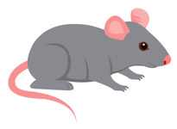
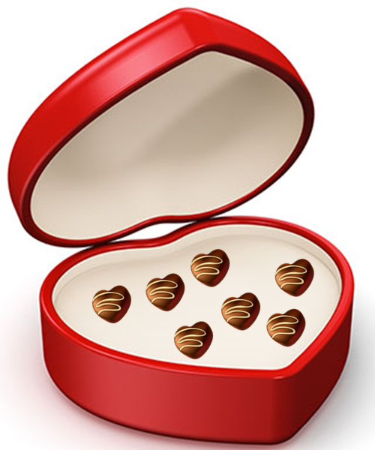
Pumpkin
May be used once by a player as a harvest stalk.
Field Mouse
May be used once by a player as a rodent. This card does not require a magician to play. Field Mouse prevents any 1 harvest stalk from producing.
Field Mouse
May be used once by a player as a rodent. This card does not require a magician to play. Field Mouse prevents any 1 harvest stalk from producing.
Field Mouse
May be used once by a player as a rodent. This card does not require a magician to play. Field Mouse prevents any 1 harvest stalk from producing.
Not so Nice Chocolate
May be used seven times by a player. 1-3: Use it to poison a magician for two rounds.
4-6: Steal one magician.
7: Turn any stalk or fluffy money into a magician.
Not so Nice Chocolate
May be used seven times by a player. 1-3: Use it to poison a magician for two rounds.
4-6: Steal one magician.
7: Turn any stalk or fluffy money into a magician.
Not so Nice Chocolate
May be used seven times by a player. 1-3: Use it to poison a magician for two rounds.
4-6: Steal one magician.
7: Turn any stalk or fluffy money into a magician.
Not so Nice Chocolate
May be used seven times by a player. 1-3: Use it to poison a magician for two rounds.
4-6: Steal one magician.
7: Turn any stalk or fluffy money into a magician.

Slide 4
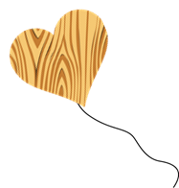
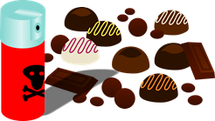
Heart Balloon
May be given to a player. Like the Trojan Horse this balloon has 1 army for each stalk you own. Using 1 die for each army the player has and you must roll higher than the number of armies.
Heart Balloon
May be given to a player. Like the Trojan Horse this balloon has 1 army for each stalk you own. Using 1 die for each army the player has and you must roll higher than the number of armies.
Heart Balloon
May be given to a player. Like the Trojan Horse this balloon has 1 army for each stalk you own. Using 1 die for each army the player has and you must roll higher than the number of armies.
Heart Balloon
May be given to a player. Like the Trojan Horse this balloon has 1 army for each stalk you own. Using 1 die for each army the player has and you must roll higher than the number of armies.
Don’t Like Chocolate?
May be used once by a player. This card will stop Not so Nice Chocolate from being used one time.
Don’t Like Chocolate?
May be used once by a player. This card will stop Not so Nice Chocolate from being used one time.

